Slide 1
Data Science Principles with Applications on Educational Data GROUP PROJECT REPORT Exploring Key Factors in Educational Data:
A Case Study on University Rankings
Group: | 06
Name: | 張育丞, | 張字青, | 周姿妤, | 黃詳諺, | Duong Van Nhat Quang
Sid: | 113598043, | 113598032, | 113598090, | 113598091, | 113998411
Date: 06/11/2025
National Taipei University of Technology
Computer Science and Information Engineering

Slide 2
TABLE OF CONTENTS
01
Introduction
02
Literature review and related works
03
Problem statement
04
Proposed models (approaches)
05
Experiments
06
Conclusions
07
Others
(Bonus)

Slide 3
01
Introduction

Slide 4
INTRODUCTION
Objective
Understand how critical academic indicators shape university competitiveness and influence rankings globally.
Integrated Analysis
Combining these features reveals deeper insights into how universities perform in a global context.
Visualization
Graphs and correlation maps enhance interpretability and strategic planning.
Outcome
Data-driven strategies can help institutions improve policies, optimize resources, and elevate their international standing.

Slide 5
02
Literature Review And Related Works

Slide 6
LITERATURE REVIEW AND RELATED WORKS
Dataset from Kaggle: "World University Ranking."
Selected 13 headers for analysis ( List in two columns )
World Rank
Institution
Country
Quality of Faculty
Influence
Broad Impact
Score
National Rank
Quality of Education
Alumni Employment
Publications
Citations
Patents
Year

Slide 7
03
Problem Statement

Slide 8
PROBLEM STATEMENT
Topic | Research Question | Method
1. Citations vs. World Rank | Does more citations lead to better rank? | Correlation + Linear Regression
2. Key Indicators Analysis | Which indicator influences rank most? | Relation Weight Analysis
3. Alumni Employment vs. Score | Does better employment lead to higher score? | Correlation + Regression
4. Country Impact | Do specific countries rank higher? | Group Analysis
5. Patents vs. Academic Impact | Which type of university ranks higher? | Comparative Analysis
6. University Type Classification | Classify by citations and patents | Clustering

Slide 9
04
Proposed Models (Approaches)

Slide 10
PROPOSED MODELS (APPROACHES)
Data Pre-processing
Handled missing & inconsistent values
Ensured logical and format consistency
Correlation Analysis
Assessed 13 indicators vs. rankings
Used Pearson correlation, regression models, and heatmaps
Feature Importance Ranking
Ranked indicators by regression weight
Visualized key features impacting rankings
Country-Level Comparison
Analyzed same-score universities across countries
Identified regional biases in rankings
5. Output-Based Grouping
Grouped by citations & patents
Compared ranking impacts with statistical tests
6. Clustering
Applied K-Means & hierarchical clustering
Profiled institutions based on research output

Slide 11
05
Experiments

Slide 12
EXPERIMENTS
Does more citations lead to better rank?
Which indicator influences rank most?
Does better employment lead to higher score?
Do specific countries rank higher?
Which type of university ranks higher?
Classify by citations and patents.

Slide 13
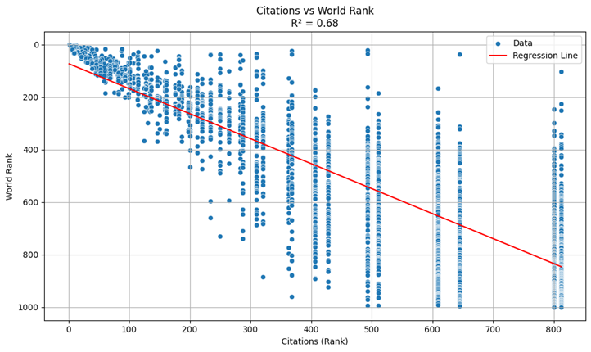
1. Does More Citations Lead To Better Rank?
Method: Correlation Analysis + Linear Regression By using citations as the independent variable and world_rank as the dependent variable, our regression analysis revealed
A significant negative correlation between citation count and world ranking.
In short, the more citations a university receives, the higher it tends to rank globally.

Slide 14
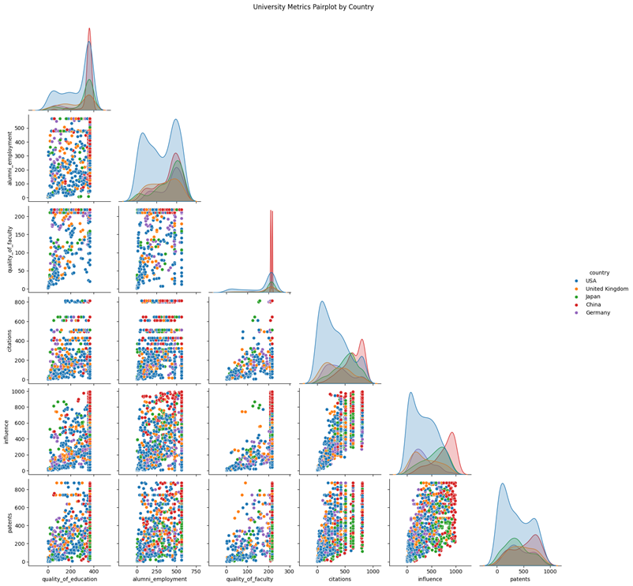
2. Which Indicator Influences Rank Most?
Method: Relationship Analysis (Regression & Correlation Coefficients)
Most influential factor Quality of Faculty stands out as the top indicator, with a significantly stronger impact than others.
Next in line Alumni Employment and Quality of Education also show strong positive influence.
Less impactful Traditional academic indicators like Citations, Publications, and Influence are relatively weaker in this model.

Slide 15
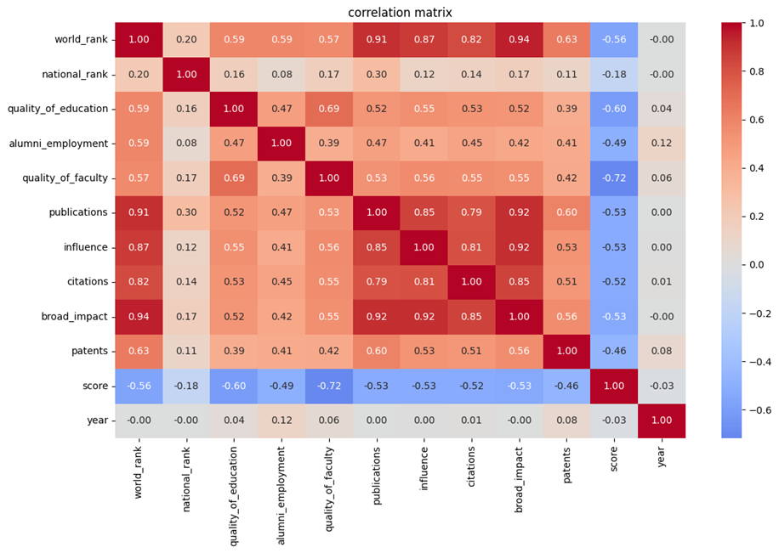
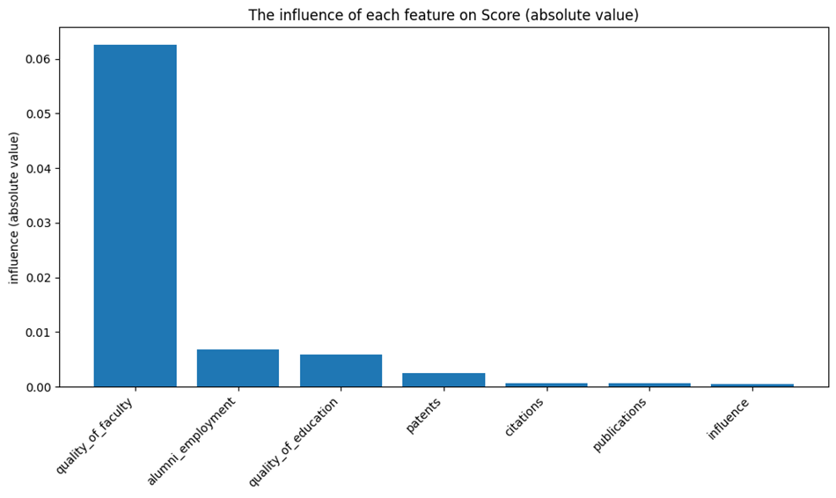
2. Which Indicator Influences Rank Most?

Slide 16
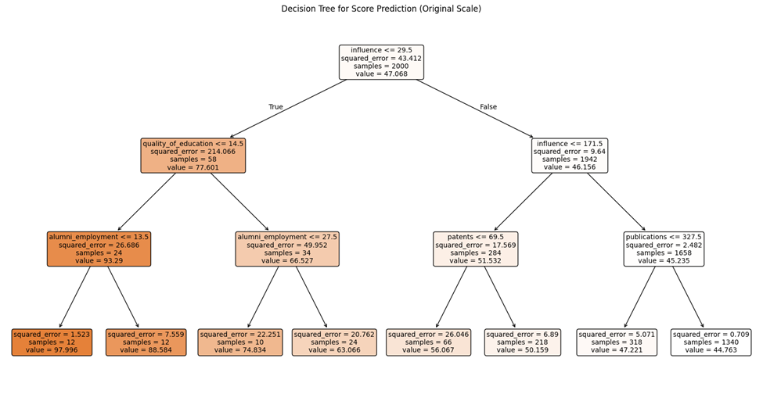
2. Which Indicator Influences Rank Most?

Slide 17
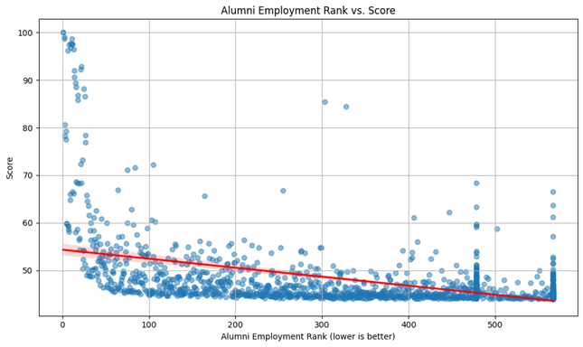
3. Does Better Employment Lead To Higher Score?
Method: Correlation + Regression Analysis
Independent Variable: Alumni Employment Ranking
Dependent Variable: Total Score
Finding Regression results show a significant negative correlation, meaning → Better alumni employment → Higher overall score

Slide 18
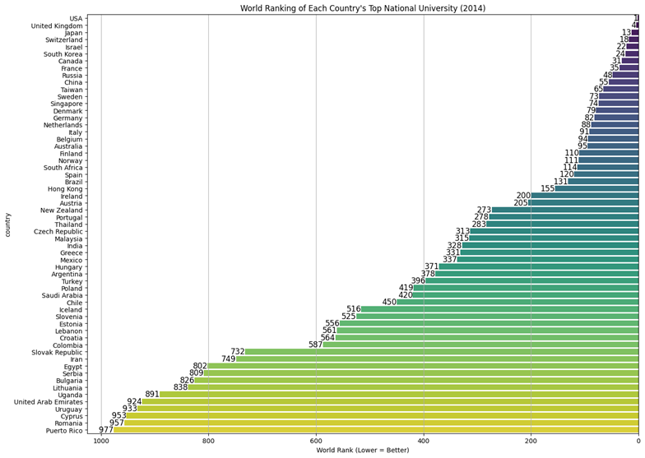
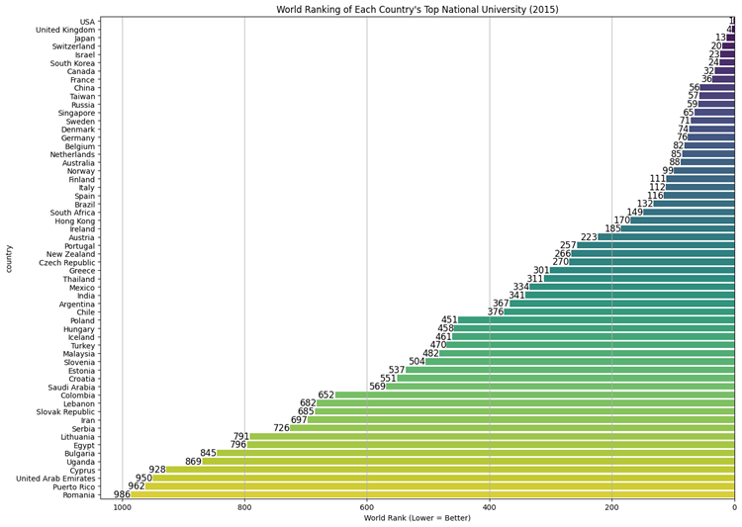
4. Do Specific Countries Rank Higher?
Method: Data manipulation and visualization By grouping universities by country, select and compare top university of each country, we found
US and UK dominate in both average ranking and citations, showing global academic leadership.
Asian countries like China and Japan have similar indicator levels but slightly lower rankings.
This suggests that even with comparable educational input, visibility and systemic factors still influence ranking outcomes.

Slide 19
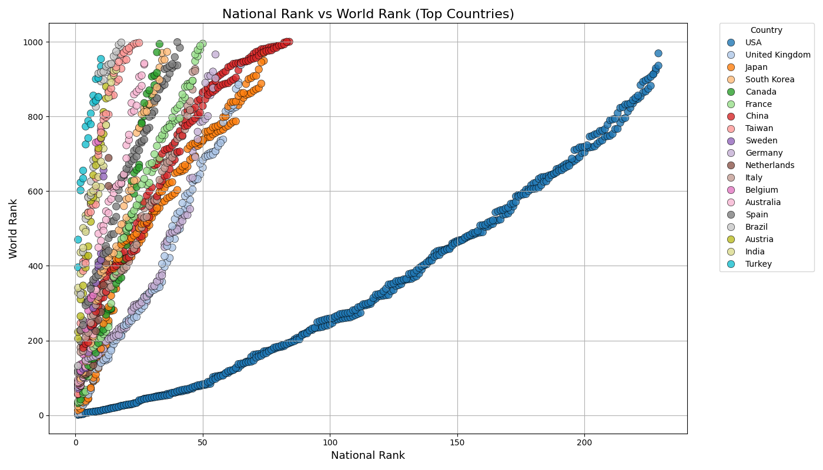
4. Do Specific Countries Rank Higher?

Slide 20
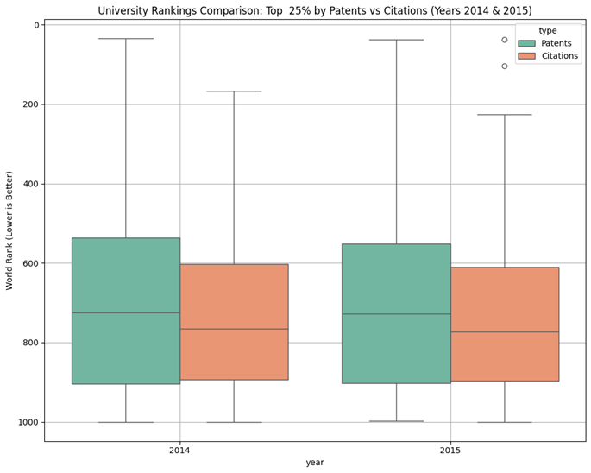
5. Which Type Of University Ranks Higher?
Method: Comparative Group Analysis
Universities grouped by high citations vs. high patents
Findings
High-citation universities rank significantly higher globally → Traditional academic output remains dominant.
High-patent universities excel in innovation and tech-transfer metrics → But have limited impact on overall rankings.

Slide 21
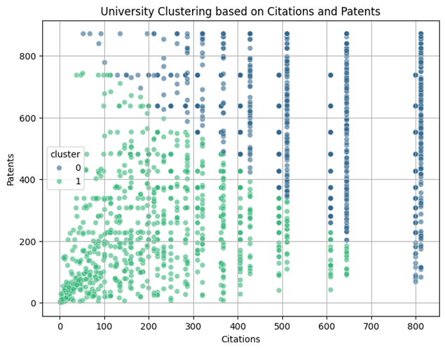
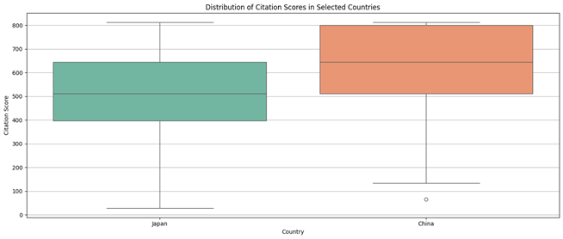
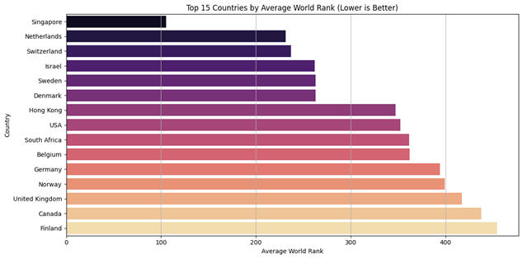
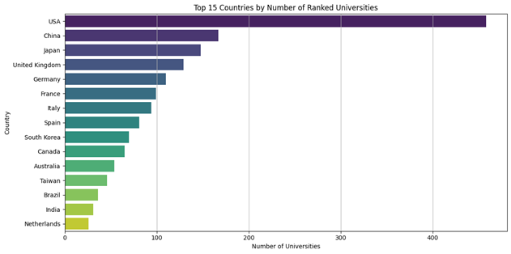
6. Classify By Citations And Patents.
Method: K-Means & Hierarchical Clustering
Features: Citations, Patents, Publications
Identified 3 distinct university types:
Academic-Oriented (high citations & publications)
Innovation-Oriented (high patents) Balanced Type (moderate across all metrics)

Slide 22
06
Conclusions

Slide 23
CONCLUSIONS
Citations, faculty quality, and alumni employment are the strongest predictors of global rankings.
Data visualization uncovers meaningful national and institutional differences.
Structural biases—such as language and publication venue—may skew rankings.
Clustering reveals distinct university types: academic, innovative, and balanced.
Takeaway: Data science not only answers the research questions but also exposes hidden biases in global ranking systems, offering guidance for strategic decision-making.

Slide 24
07
Others (Bonus)

Slide 25
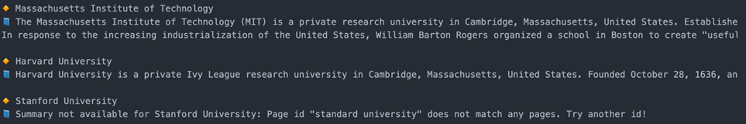
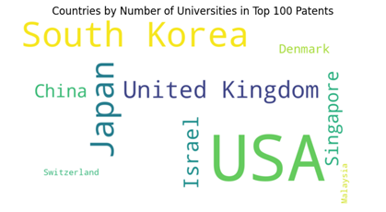
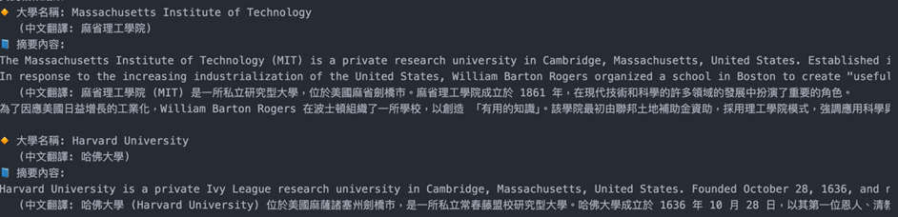
OTHERS (BONUS)
To enhance the depth and creativity of our analysis, we added a keyword cloud to visualize the visibility of different academic themes across countries.
We also experimented with integrating Large Language Models (LLMs), combining Wikipedia API, web scraping, and translation tools to build a semantic-enhanced system. Users can input a university name and receive both English and Chinese summaries.
Results show that combining LLMs with open APIs breaks the limitations of static data and adds semantic depth and flexibility to the analysis.

Slide 26
Thank You
If you have any questions, please feel free to contact us by email.
t { 113598043, 113598032, 113598090, 113598091, 113998411 } @ntut.org.tw

